Slide 1



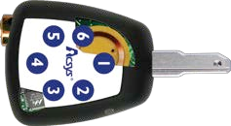



Acsys System Introduction
mity / RFID coil user to use the ge (optional)
AcsysLocks CANNOT be
BUMPED or PICKED and
are very hard to DRILL
Since there is no power in the
locks. We can offer Euro – Din
cylinders and padlocks in
various sizes
Acsys Keys can be fitted
with a Proxi
allowing the
key as a bad
All models are
Wire-Free
EASY to Install
EASY to Maintain
The COMMUNICATION between
locks, keys, software and all its
data is encrypted using 128-bit
AES ENCRYPTION, making the keys
IMPOSSIBLE to COPY
The ONLY power source for the
Acsys system comes from the
key. Typical Battery life-time =
2 years
ED AT THIS TIME
LED light on the AcsysKeys gives user information:
GREEN – ACCESS GRANTED
ORANGE – ACCESS DENI
RED – ACCESS DENIED
4 blinks (color depending on the above) – LOW
BATTERY
Activity
The key has a chip that can be The key and lock each The lock has a built-in chip programmed to open one or have a built-in MEMORY that can be programmed to up to 100,000 locks that keeps track of the last accept the entry of
1,000 events, WHO went 1,000,000 keys
WHERE and WHEN
Acsys Keys have a built-in CLOCK
and CALENDAR So we can assign
temporary access rights (Mon-Fri)
and also limited in time (08:00 –
18:00)
LOST/STOLEN KEYS can be
DELETED from the system and
from the locks where it had access
Reports
The Acsys keypad key is the best protection against lost/stolen keys. If someone finds a lost/stolen key, they cannot use it as a PIN is needed to be entered on to the key before usage. If someone inputs wrong PIN 5 times, the key will automatically be blocked and
needed to be reset via the Acsysware management software.
PL5 PL2 Button Lock Blind Lock Double Lock
It’s all about security & Productivity!
www.acsys.com / info@acsys.com

Slide 2










Why Acsys ?
Office
Home
Gates Containers
Car
Park
USE ONE KEY FOR EVERY DOOR
NO WIRING, EASY TO INSTALL
ONE SOLUTION FOR EVERY PLACE
NO MORE KEY BUNDLES
Where and When was it used?
Mon– Fri
24hrs
365Days
24hrs
Mon—Fri
08:00-20:00
Activity
Reports
Activity
Reports
EASY TO CHECK WHERE THE KEY WAS USED AND WHEN
LOST ACSYSKEY=NO LOCK CHANGE
MECHANICAL LOST KEY=LOCK CHANGE
CONTROL WHERE AND WHEN USERS CAN ENTER
VERIFY WHERE AND WHEN USERS CAN ENTER
It’s all about security & Productivity!
www.acsys.com / info@acsys.com

Slide 3

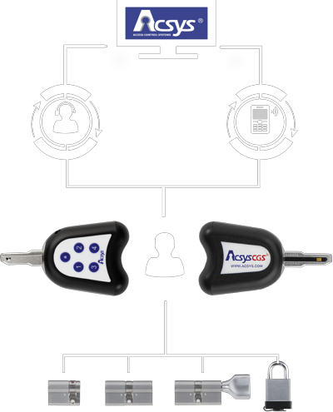

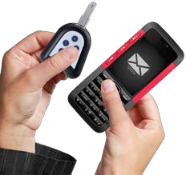

Acsys CGS Solution (Remote Key Activation)
The Acsys Code Generating System (CGS) is a simple, yet powerful way to manage
access to remote sites and assets in real-time.
Through a phone and an Acsys CGS Key with Keypad, the NOC can grant access
rights in real-time and be notified on site arrival and exit.
The CGS solution is offered exclusively by Acsys and is unique approach to remote
site access control.
ANY
PHONE
ANY
PHONE
The concept is simple, every user now has a key, but none of the keys can be used
UNTIL a random, single-usage, time-limited code is created by the software for the
key(s).
OPERATOR
SMS
Whenever a user requires Access to a site or asset, he needs to request the code by
call/sms to the NOC and upon verification of the user credentials the code will be
issued to the user who in turn enters it on the key allowing him to have access and
ONLY on the site and assets where the NOC wants the user to have access.
The Acsys CGS solution is the safest and most convenient way to control access to
remote sites and assets and the best way to REDUCE DOWN-TIME by allowing users
to get to the site without the need for picking-up or returning keys.
USER
CGS Working Principle
It’s all about security & Productivity!
www.acsys.com / info@acsys.com

Slide 4


Remote key Activation (Call/SMS)
CALL
SMS
CODE
CODE
1. The user has a password key and needs access to some locks
2. The user calls the
password, and receives a
1. The user has a password key and needs access to some locks
2. The user sends SMS and password requesting access and gets a code to use the key
operator, gives his
code to use the key
4. The user can now use the key on the specified locks for a defined duration
3. The user inserts PIN
FLASH= can use the key
4. The user can now use the key on the specified locks for a defined duration (5min/30min/1HR/8HRS)
3. The user inserts PIN code to use the key, GREEN FLASH= can use the key
code to use the key, GREEN
(5min/30min/1HR/8HRS)
It’s all about security & Productivity!
www.acsys.com / info@acsys.com

Slide 5
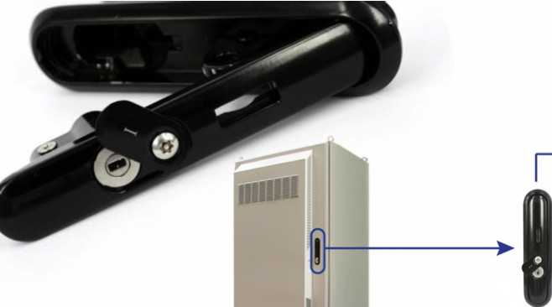




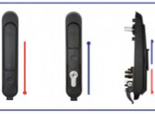
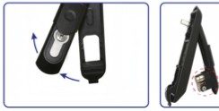

Battery/AVR/3G/4G/LTE Cabinet Lock
Replace mechanical lock with an
Acsys Blind Lock
Wide Variety of Handles
I
I
Other Models
Available
Close Open
360°
turn
Acsys Blind Lock
'
.............. - '.
·;-.. .- --~- - ---·. -~- - ·:
Open
Close
It’s all about security & Productivity!
www.acsys.com / info@acsys.com

Slide 6
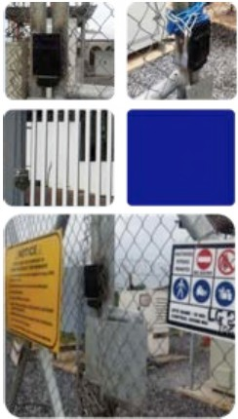
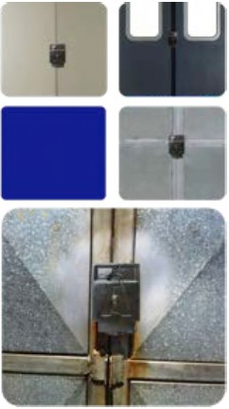
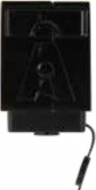
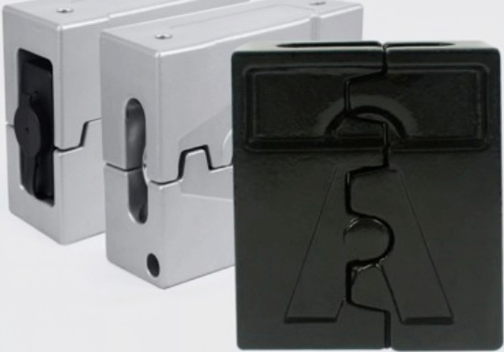




High Security HASP for Front Gate and Storage Rooms
THE SAFEST PADLOCK
IN THE WORLD
,1/
Clolt -
I...
r-.
)
......
L--,
+
+
l....
r-
-
.....
s^{-..-.}
' .f
\
~
®
®
~@
~
~~
STEP 1
STEP 2
STEP 3
STEP 4
It’s all about security & Productivity!
www.acsys.com / info@acsys.com

Slide 7
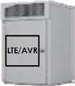

Acsys Stackable Key Solution
•
The stackable key solution is another world-
unique Acsys development as it offers a
previously unknown level of control over
access to high-value or sensitive sites.
The SK solution works as a bank safe where
two keys are required but only requires one
lock instead of two and can also be used on
padlocks so the solution is available for indoor
and outdoor applications.
The system can be programmed so that up to
5 keys need to be used in order to open 1 lock
The solution can be used in conjunction with
Acsys CGS remote key activation.
CONCEPT
•
Worker
Worker alone cannot open the lock!
•
•
Manager
Manager alone cannot open the lock!
EXAMPLE
1
1
Worker
Worker
2
OR
Manager
2
3
Manager
Security
Worker & Manager together use 2 keys to open a lock
Worker ，Manager & Security staff together
use 3 keys to open a lock
It’s all about security & Productivity!
www.acsys.com / info@acsys.com

Slide 8
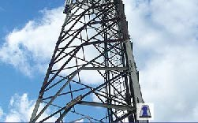
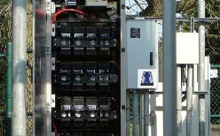
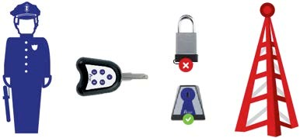
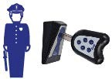
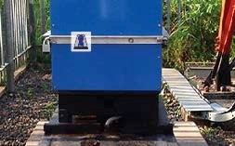
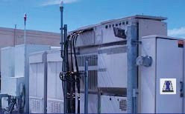
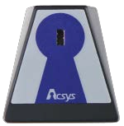
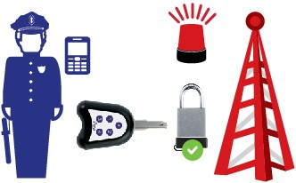

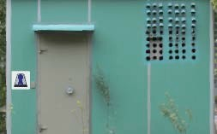
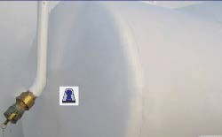
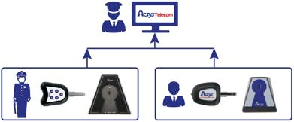
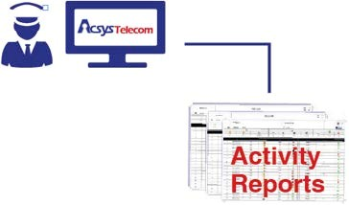
On-site Time & Attendance Solution
TOWER
BATTERIES
1. The guard has key for T&A but no access rights to locks on-site
2. When the guard arrives on-
his key in logger
site to report to duty, he inserts
CGS
GENERATOR
LTE CABINET
30 MINUTES
4. In case of emergency, if the guar
need access to the site, he can
request CGS code and enter site
3. The guard needs to re-insert his
key at certain time interval (e.g. 30
minutes) to make sure he stays on-
site.
4. In case of emergency, if the guard
BTS SHELTER
FUEL TANK
CONTROL:
· PREVENTIVE MAINTENANCE
· SCHEDULED MAINTENANCE
· EMERGENCY MAINTENANCE
· ADHERENCE TO SLA
· USER ON-SITE PRODUCTIVITY
ADVANTAGES:
· NO CABLE
· NO POWER
· NO BATTERY
· NO MAINTENANCE
5. During monthly site audit, the guard’s attendance information can be download from T&A logger or guard can upload key event log on USB/IP programmer
6. After the logs have been uploaded, a full report shows the guard attendance on site(when/where/how long)
It’s all about security & Productivity!
www.acsys.com / info@acsys.com

